Slide 1
Stonehenge Men’s Golf Association 2023 Membership Guidebook

Slide 2
TABLE OF CONTENTS
3 Letter from the MGA Committee
4 Saturday Tournaments
5 Two-Man Match Play Tournament
7 MGA Blitz
9 MGA Cup Points
10 MGA Sponsored Christmas Party
11 Handicapping
12 MGA Committee
13 MGA Website/Social Media

Slide 3
Dear Stonehenge MGA Members,
Welcome to the Stonehenge Men’s Golf Association! The MGA is the dedicated group of fellow members responsible for creating exciting and challenging men's golf formats and tournaments, all for you with your interests and your schedule in mind. Quarterly tournaments with enticing formats and dramatic outcomes; organized Saturday golf opportunities; seriously fun summer-long match play; abundant social events to meet with friends, old and new!
The vision for the MGA is to provide an exceptional member experience by increasing both playing opportunities and camaraderie. Through this vision, you can expect well planned golf tournaments and social events for the enjoyment of not only our current members but also for new members who are looking for a complete and rewarding men's golf experience.
And this is where the fun begins!
Four fun-filled Saturday golf tournaments with exciting formats; cart, beverages, lunch and prizes included! Again, all Saturday MGA Tournaments will now include 18 holes of golf, carts, lunch buffet and on-course beverages!
Two-man match play tournament all summer long: a great skills challenge and played strictly by the rules!
MGA Saturday Blitz with priority tee times. Great opportunity to play weekly competitive golf and meet new friends!
Season-long MGA Points Cup that recognizes and rewards year-long participation and tournament competition. Grinding is good!
Club-wide Christmas Party Sponsored by the MGA - already reputed to be the BEST party of the year!
This Guide is your single source for superb men's golf entertainment. You may visit our website at www.stonehengemga.com for information about your MGA. Please also joining our Facebook page by searching for “Stonehenge MGA”. We know that we don't have all of the answers, so please contact any MGA Committee member with your questions or suggestions for improvement.
The MGA committee thanks you for your membership. Without your support, none of this would be possible. Remember, this is YOUR Men’s Golf Association...your participation is what makes this GREAT!
Sincerely,
The MGA Committee
Match Play
MGA Christmas Party
Interclub
Qualifier
Weekend
Tournaments

Slide 4
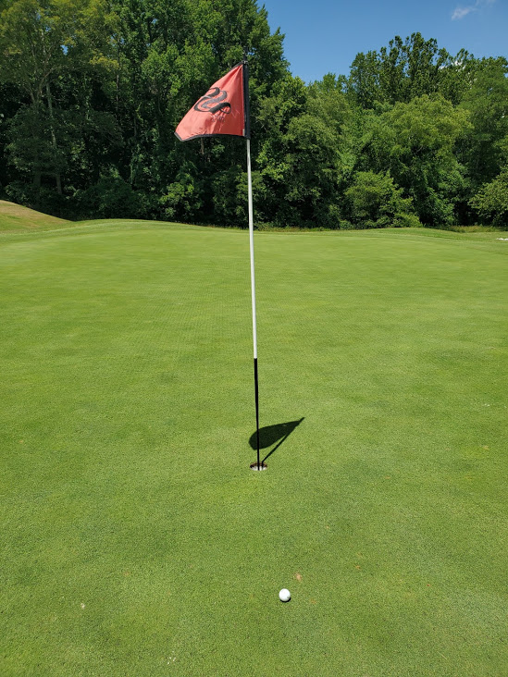
SATURDAY TOURNAMENTS
MGA Saturday Tournaments
ABCD Players, AB Player – AB Players Best Ball Gross / CD Player Best Ball NET Score. Combine Score for Team Score**
Prizes will be awarded to both low gross and low net players for several places (depending on the number of participants).
Closest to the pin contests on all par 3’s.
Players must sign up by Wednesday at 5 p.m. prior to the tournament.
Entry fee includes drinks on the course, cart, and lunch
May 6th, 2023
9 a.m. shotgun
Red, White and Blue
Format will be team Gross and Net with 6 holes each from red, white and blue tees. Players 60+ will play 6 holes from red, green and white tees. Each player decides which tees to play on each hole. Teams will be randomly selected using A, B, C, D players.
Prizes will be awarded to both low gross and low net teams for several places (depending on the number of participants).
Closest to the pin contests on all par 3’s.
Players must sign up by Wednesday at 5 p.m. prior to the tournament.
Entry fee includes drinks on the course, cart, and lunch.
July 1st, 2023
9 a.m. shotgun
Individual Gross and Net **
Prizes will be awarded to both low gross and low net players for several places (depending on the number of participants).
Closest to the pin contests on all par 3’s.
Players must sign up by Wednesday at 5 p.m. prior to the tournament.
Entry fee includes drinks on the course, cart, and lunch.
September 2nd, 2023
9 a.m. shotgun
Meatloaf Open
Format will be 4-man teams using handicaps (teams will be randomly selected using A, B, C, D players).
All 4 players will tee off and select one player’s drive from which to play. The player whose tee ball is selected, must play the hole alone from that spot as the “choker” player. The other 3 players play the hole from that spot using a scramble format. The team score will be the sum of the net score of the “choker” and the gross score of the other three golfers playing scramble format on each hole.
Prizes will be awarded to the teams with the lowest overall scores and closest to the pin contests on all par 3’s.
Players must sign up by Wednesday at 5 p.m. prior to the tournament.
Entry fee includes drinks on the course, cart, and lunch.
October 21st, 2023
9 a.m. shotgun
** Age appropriate tees.

Slide 5
TWO-MAN MATCH PLAY
With great participation and feedback from the MGA members, the MGA is pleased to bring back the 2-Man MGA Match Play Championship for 2023.
Sign up as a single or two-man team. If you sign up as a single, we will provide you with a partner. Tournament fees and sign-ups are due by May 15. Late sign-ups will not be accepted.
A pod system similar to the World Cup Soccer Matches will be developed and a random draw will determine the teams in each pod. After round-robin play in each pod, the top 2 teams in each pod will advance to the Championship bracket and the other 2 teams will go to the consolation bracket for a single-elimination tournament.
The MGA is adding championship pods and playoffs for teams that prefer to play their match's gross. Teams will be required to start the season with a combined course handicap of no less than 5 strokes. This format contingent upon interest from at least 6 teams.
The MGA will provide you with 3 matches on May 15th that you will need to arrange and play by August 15th. After the conclusion of round-robin pod play, a single elimination tournament will begin to crown the MGA Champion Team. This year there will also be a consolation bracket to allow for more play. Prizes will be awarded at the MGA Holiday Party. In addition, matches will contribute to season-long Stonehenge Cup point system
If you are interested in participating, please e-mail stonehengemga@gmail.com with the information below.
Name(s):
Current Course Handicap(s):
Team Member(s) E-mail / Phone:
Team Member: Age 49 & below, 50-59 or 60+
Age-appropriate tees will be used

Slide 6
TWO-MAN MATCH PLAY RULES
Format: Best ball 2-man match play net (each team’s best net score each hole) – no carryover holes. Decide if you are going to play a 9 or 18 hole match prior to teeing off.
Tees: Age-appropriate tees should be used (<50 = white tees, 50-59 =green tees and 60+ = gold tees).
Handicapping: Handicaps are based on your current Course Handicap as of your match. When calculating your Course Handicap, please make sure that your handicap is based on the tees you will be playing. The MGA recommends using the GHIN or VSGA app to prepare your match play handicaps. The pro shop can also help you prepare/review your card. The maximum spread between teammates will be 10 strokes. For example, teammate A is a 6 handicap and teammate B is an 18 handicap, teammate B will calculate strokes based off a handicap of 16. The Course Handicap of all four players is reduced by the Course Handicap of the player with the lowest handicap, who then plays from scratch.
Please make sure to post your rounds to GHIN – not doing so may disqualify you from the tournament.
Tie Breaker: If the match ends in a tie, matching cards should be used to determine the winner based on match play record for the last nine holes. If the tying teams have the same record for the last nine, determine the winner based on the last six holes, last three holes and finally the 18th hole.
Pod Play: All matches must be completed and submitted to stonehengemga@gmail.com by August 15th. If results are not received, both teams will receive a loss. After August 15th, when the preliminary matches have been completed, there will be a seeded single elimination tournament to crown a 2023 MGA Team Match Play Champion. We will also have a consolation bracket for teams not qualifying for the championship bracket.

Slide 7
2023 MGA (1/2)
The Saturday BLITZ is designed to give MGA members an opportunity to play competitive golf every other Saturday morning with preferred tee times from 8:30- 10:30 AM. At this time, we have been guaranteed forty (40) spots so please sign up early to guarantee your spot in the Blitz.
All games are cash, and we will play different formats depending on the number of players each week. Most games will be based on net score payouts. Birdie Cuts will be paid as well! Payouts will depend on participation. This is a great way to meet new members in the club or play with other members you haven’t played with in a while. Here are the details:
You must be a member of the MGA.
You must have an established handicap. See tournament committee if you do not have a handicap.
Participation in the Blitz each week will count towards the Stonehenge Cup.
See the schedule at the end of this section for dates. We will also have a schedule of events and the rules posted in the Pro Shop and the Clubhouse for all to see.
Sign up with Golf Genius or call the Pro Shop by Tuesday afternoon by 5 PM before the Saturday event. If you sign up late, you can be added to a waiting list but can ONLY play if someone cancels. NO EXCEPTIONS.
Tee times will be assigned by the Pro Shop from 8:30 AM to 10:30 AM. This is not a shotgun start.
The entry fee is $10. This will be used as prize money for that day’s Blitz (the amount of payout will vary according to participation) and towards the MGA Cup. (50% to net prizes and 50% to birdie cuts)
All scores MUST be entered into the GHIN handicap system. Failure to enter scores could result in suspension from future events!
Golf carts are not required for Blitz events.
All score cards are to be turned into the Pro shop at the end of the round; winning scores will be tabulated, and prizes will be awarded based on the day’s game and posted in Golf Genius.
The committee has worked very hard in this endeavor, and we are very excited about the BLITZ! We hope you will take advantage of this great opportunity to be an active participant in the MGA and help support the MGA at the club. We all look forward to seeing you Saturday mornings.

Slide 8
2023 MGA (2/2)
All Blitz tee times are from 9:00 -10:30 a.m. The Saturday Blitz Schedule is below:
April 8th
April 22nd
May 27th
June 3rd
June 17th
July 15th
July 29th
August 5th
August 19th
September 16th
October 7th
November 11th
We hope you will take advantage of this great opportunity to be an active participant and help support the MGA at the club. We all look forward to seeing you Saturday mornings.

Slide 9
MGA CUP POINTS
The MGA will continue an exciting way to participate in MGA events for a chance to win up to $1,500 in prizes and the MGA Cup. You will be awarded points for participation and for good play in tournaments. The point leaders at the end of the season will be awarded prizes based on the total points earned.
Tournaments (Gross & Net Winners)
Participation – 5 points
Third Place – 10 points
Second Place – 15 points
First Place - 20 points
Blitz
Participation – 5 points
Match Play
Participation – 3 points per match
Winner – 10 points (both brackets)

Slide 10
MGA SPONSORED CHRISTMAS PARTY
In cooperation with the Club, the MGA Committee will host the annual Christmas Party and will invite ALL club members to the party. The Club will determine the price per attendee at a later date, but, as in past years, the cost of attendance for first combination of 75 MGA members and their guests will be covered by the MGA. Each MGA member can bring one guest. Year-end MGA awards, trophies, and prizes will be presented at the party.

Slide 11
HANDICAPPING
Just a word on handicapping: Golf is fun only if it's fair. The game was developed based solely on integrity, and honest and timely posting of scores is a requirement of the USGA Handicap System. It is expected that all MGA members will honor this requirement. All players should post all rounds played to the GHIN system.
“Success in this game depends less on strength of body than strength of mind and character.” – Arnold Palmer

Slide 12
MGA COMMITTEE
Officers:
Carter Sargeant – President
Corey Divine – Vice-President
Haider Sharifi – Treasurer
Charles Allen - Secretary
Other Members:
Chris Sweeney
Jim Zamparello
Jason Garrett
Paul Thompson
Sam Williams
Thor Thorsson

Slide 13
MGA on Social Media
For more information on the Stonehenge Men’s Golf Association go to the website below:
https://www.stonehengemga.com/
Join Us on Facebook! Search for Stonehenge MGA
Email the MGA at stonehengemga@gmail.com to join or get additional information!
Stonehenge MGA information is also posted to both;
Facebook = Stonehenge MGA
Instagram = stonehengemga

